Slide 1

Force and vehicle saftey
Melanie Yee

Slide 2
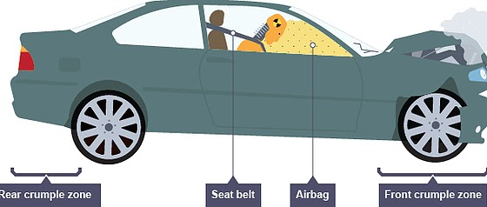
Principle A
Crumple zone
Crumple zones are areas of a car that will bend and crumple in the event of a collision. By absorbing some of the impact's energy, this stops the energy from being transferred to the car's occupants. Since engineers must take into account a number of variables, including size, weight, frame rigidity, and the stress the car will receive in a collision, designing a crumple zone is not a simple operation.
For Example, an SUV will unquestionably collide more violently than a hatchback or a smaller automobile simply because of its weight
The best way to reduce the initial force in a crash with a given amount of mass and speed is to slow down the deceleration. A collision's force can be significantly reduced by reducing the deceleration by merely a few tenths of a second.

Slide 3
Principle B
Crumple zone impact/force:
Crumple zones aid in redistributing the impact's force. The intention is to direct the force away from the occupants because it must all go somewhere. Consider the force used in a crash as having a budget. Everyone inside the car at the time of the impact and everything that happens to the car during the impact all use some of the force. A certain amount of force is transferred to a non-stationary object, such as a parked car, if the car strikes it.
Crumple zones absorb as much force as possible to protect the occupants and other car components from harm.

Slide 4
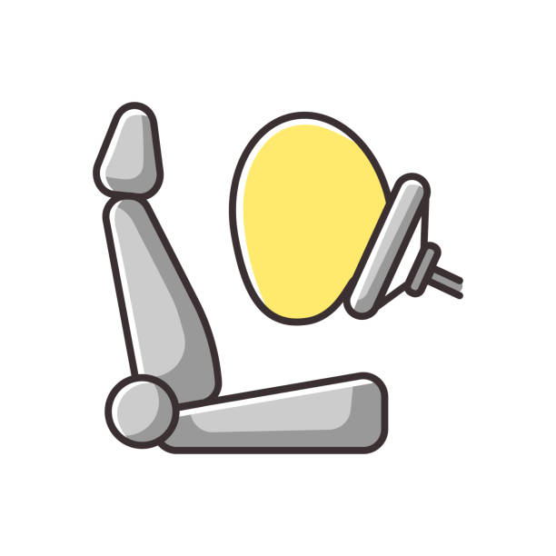
Principle C
Air bags/seat belts - stops transfer of energy:
Seat belts keep you from bouncing around inside the car in the event of a collision. They are, however, designed to stretch slightly in the event of a collision. This lengthens the time it takes for the body's momentum to return to zero, reducing the forces acting on it.
Air bags lengthen the time it takes for the head's momentum to return to zero, reducing the forces acting on it. They also serve as a soft cushion and help to prevent cuts.

Slide 5
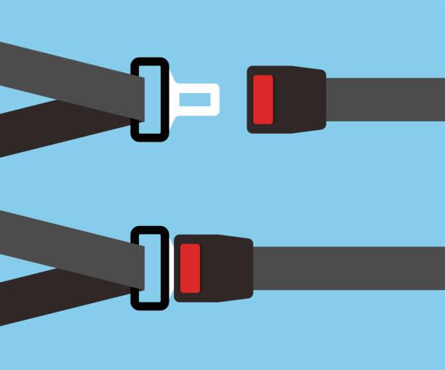
Principle D
Seat belt - law of inertia - stops person from flying out:
Law of Inertia states that If a body is at rest or travelling at a constant speed in a straight line, it will stay at rest or continue to move in a straight path at constant speed until acted upon by a force.
The major reason you do not fly out of the vehicle following an accident is due to inertia. The inertia keeps the bodies moving at the same time until the seat belts stop them. Even if the crash is severe, your body will not be flung out of the car provided the seat belts are properly fastened.

Slide 6
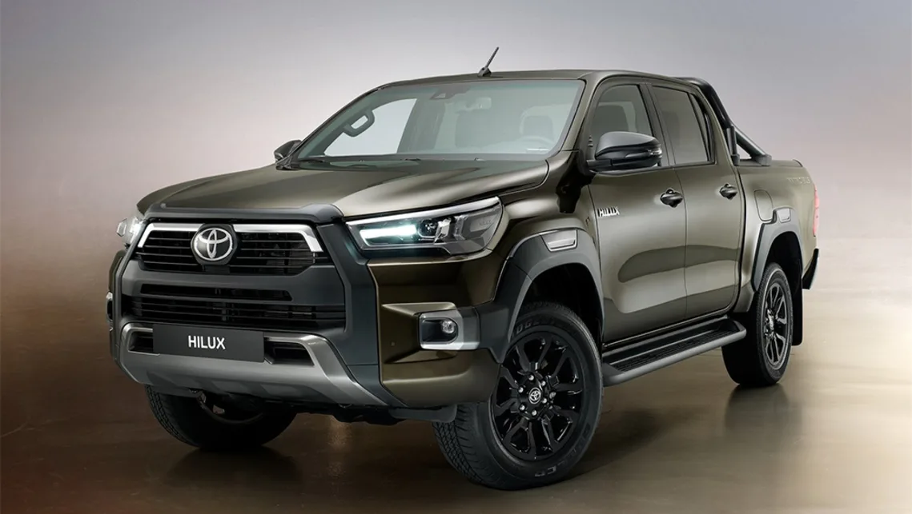
2021 Toyota Hilux
The Toyota Hilux offers many safety features that both protect and assist the passengers that occupy the vehicle.
Safety assist includes features such as Electronic Stability Control and Lane Keep Assist.
Adult occupation protection has Airbags for the front seats, that being the driver and the front passenger as well as side curtain airbags. Automatic Emergency Braking is also included.

Slide 7
Safety features that comply with previously mentioned physics principle/s:
The airbags that the Toyota is equipped with complies with Principle C and are an essential part of safety for the passengers inside. As there are multiple airbags situated in the front passenger and driver seats, the side curtain airbags allow a better chance for survival of a collision as the head may be swung around and would land on it, cushioning it's impact as well as slowing down the tranference of force.
Due to its alignment with the Law of Inertia, seat belts fall under Principle D. In the event of a possible collision, the automatic braking system that the Toyota Hilux contains would sense fast, oncoming vehicles coming into the direction of the car the occupant resides in. With this action, the car would immediately stop and with the seat belt fastened, it would halt the occupant from any violent movement towards the interior of the vehicle.

Slide 8
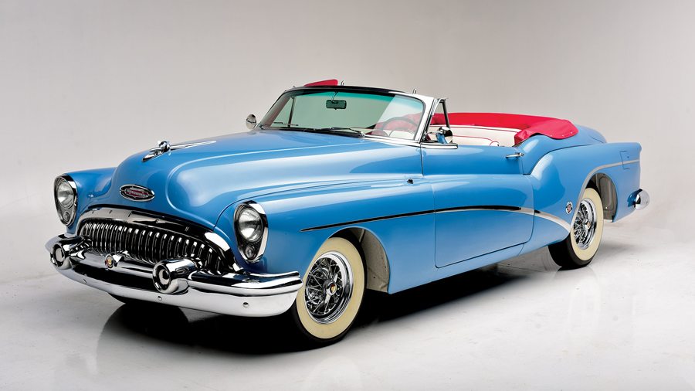
Chosen vehicle from before the 60’s: 1953 Buick Skylark
Many owners of the Skylark had submitted complaints about the vehicle when it came to using the brake. People had said that the car would be working completely fine until the brakes wouldn't budge at any given moments and because of this, accidents and collisions were narrowly avoided due to the faulty brake. This is also what caused the discontinuation of the Skylark.
The Buick Skylark also didn't have seat belts in the rear seats until 1967 which would have been extremely risky in the case of a car accident because an occupant's injuries would have been severe if they were to be suddenly thrown out of the vehicle.

Slide 9
Unsafe features with physics principles:
With the lack of functioning breaks, Principle D may be more in line with this feature. With the car going at accelerating speeds, this makes give a higher chance of collisions and accidents as there would be nothing to stop the car if the brakes were faulty. The only thing that would stop the car would be whatever it crashes or collides into.
Principle D is also particularly relevant to this given the absence of seatbelts. The person or persons sitting in the front seats would have flown out if there had been a collision, suffering serious injuries.

Slide 10
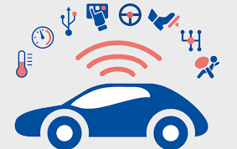
The role of safety in a car design:
The importance of safety in automobile design gives passengers the highest chance of surviving an accident.
With new systems and technology included into each new vehicle design, the driver can become more alert and the car itself can be saved in the event of an accident.
The technology in cars is continuously improving, making them safer and more useful, potentially saving the lives of the people inside and even preventing collisions altogether.

Slide 11
Improvements that could be made with the principles of physics:

